Slide 1
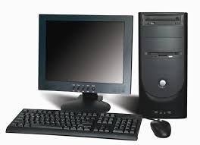
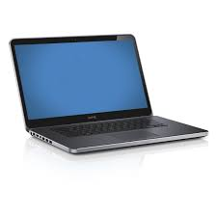
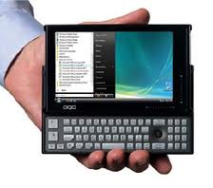

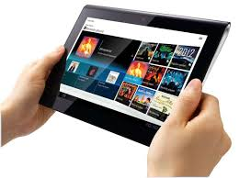

What is a computer?
How many of you have these?

Slide 2
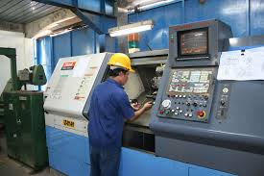

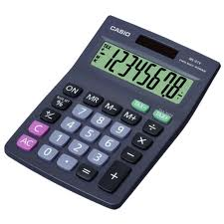
What about these?

Slide 3
A computer is a programmable machine.
The two principal characteristics of a computer are:
it has a specific set of instructions ( including arithmetic and logical operations) which it can execute
it can execute a prerecorded ( in memory) a list of instructions (a program).

Slide 4
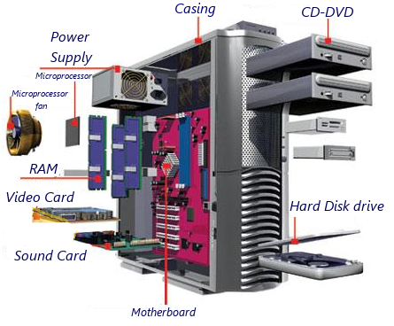

Slide 5
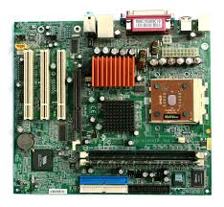
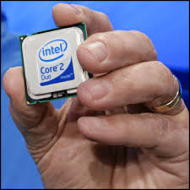
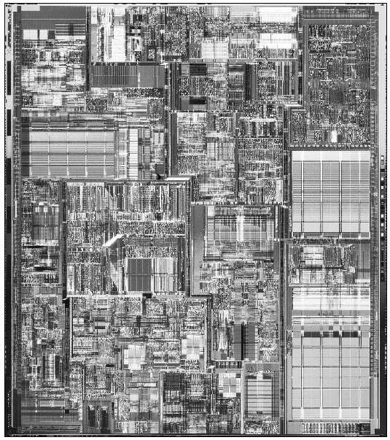
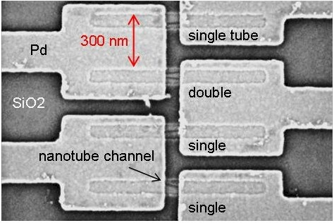

Slide 6
A Computer
A computer is an electronic device that processes data and performs tasks according to a set of instructions called a program. It is designed to accept input, store and manipulate information, and produce output.

Slide 7
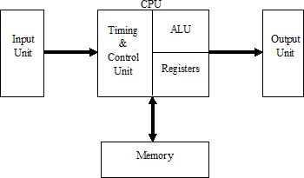
A Computer
A computer has the following units:

Slide 8
CENTRAL PROCESSING UNIT (CPU)
The CPU is the brain of the computer.
CPU can have one or many Microprocessors

Slide 9
A microprocessor
is a compact electronic component that serves as the central processing unit (CPU) of a computer or other digital device. It is an integrated circuit (IC) that performs arithmetic, logic, control, and input/output (I/O) operations, by fetching instructions from memory & executing them
Key Features of a Microprocessor:
Core Component: Acts as the "brain" of the system, managing and executing tasks.
Compact Design: Built on a single chip, integrating millions or billions of transistors.
Programmable: Executes a sequence of instructions (software) stored in memory.
Versatility: Used in various applications, from personal computers to embedded systems in everyday devices like microwaves, smartphones, and cars.

Slide 10
Functions of a Microprocessor:
Arithmetic Operations: Performs basic mathematical calculations (e.g., addition, subtraction).
Logical Operations: Handles logical comparisons (e.g., AND, OR, NOT).
Data Handling: Transfers data between memory, registers, and other components.
Control Operations: Directs the flow of data and instructions within the system.
Example:
A popular microprocessor is the Intel Core series, used in personal computers, or the ARM processors, widely used in smartphones.

Slide 11
Characteristics of a Microprocessor:
Clock Speed:
Indicates how fast a microprocessor can execute instructions, measured in Hertz (Hz), typically gigahertz (GHz) for modern processors.
Word Length:
Refers to the number of bits the microprocessor can process at a time (e.g., 8-bit, 16-bit, 32-bit, or 64-bit).
Instruction Set:
The set of operations the microprocessor can perform, divided into CISC (Complex Instruction Set Computing) and RISC (Reduced Instruction Set Computing) architectures.
Number of Cores:
Modern microprocessors often have multiple cores (dual-core, quad-core, etc.), enabling parallel processing and multitasking.

Slide 12
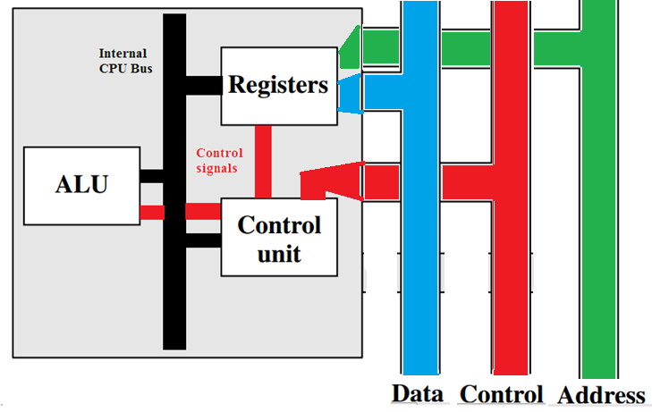
Internal CPU bus is used to transfer data between register to registers, register to ALU .Control signals are generated by control unit to direct data movement & operations to be performed by ALU

Slide 13
Functions of processor
The steps/cycles involved in execution of a single instruction is called Instruction Cycle .
• Fetch instruction: The processor reads an instruction from memory (register, cache, main memory).
• Interpret/Decode instruction: The instruction is decoded to determine what action is required.
• Fetch data (Indirect ) : The execution of an instruction may require reading data from memory or an I/O module.
• Process data /Execute instruction : The execution of an instruction may require performing some arithmetic or logical operation on data.
• Write data: The results of an execution may require writing data to memory or an I/O module.

Slide 14
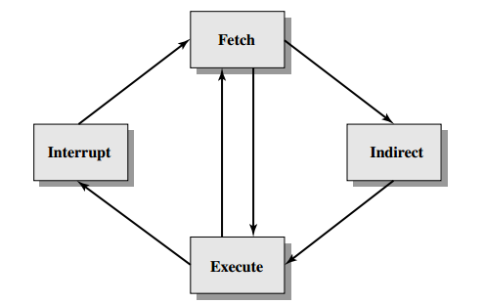
main line of activity consists of continuous instruction fetch and instruction execution activities.
After an instruction is fetched, it is examined to determine if any indirect addressing is involved. If so, the required operands are fetched using indirect addressing.(if data is in registers, then this indirect cycle is not required)
Following execution, an interrupt may be processed before the next instruction fetch.

Slide 15
Instructions
Instructions specify the operation to be performed by the CPU.
Instruction = operation
operand = data to be operated upon
The collection of different instructions that the processor can execute is referred to as the processor’s instruction set
Every processor has unique instruction set
What is a Program?
A particular combination( sequence ) of instructions to carry out a task .
Eg program to calculate average of N numbers

Slide 16
The elements of machine instructions
Operation code ( Do this )
Specifies the operation to be performed (e.g., ADD, I/O). The operation is specified by a binary code, known as the operation code, or opcode.
Source Operand reference ( To this) -
The operation may involve one or more source operands, that is, operands that are inputs for the operation.
Eg ADD requires two operands
Result Operand reference (Put the answer here)
Next Instruction Reference ( When you have done that, do this.)
This part of instruction tells the processor where to fetch the next instruction after the execution of this instruction is complete
The input and output operands are stored in
Main memory (or virtual memory or cache) , CPU register , I/O device

Slide 17
Instructions is also called as Machine Code
It is in the Binary form. Each instruction has a unique bit pattern
Usually represented by assembly language for our understanding. Since It is impossible to remember the large binary formats, so symbolic representations are used, which are called as mnemonics.
For example ADD, SUB, MUL, DIV mnemonics represent addition, subtraction, multiplication, division operation respectively.
Another program(assembler) accepts these symbolic inputs & converts them into binary form
Eg ADD R1, R2 is converted to 2F,D9 for a particular processor

Slide 18
compiler
High level language prog ===== > Machine language prog
assembler
Assembly language prog =======> Machine language prog

Slide 19
High level language
#include <stdio.h>
int main() {
printf("Hello, World!\n");
return 0;
}

Slide 20
Assembly language program for Hello World
.file "hello.c"
.section .rodata
.LC0:
.string "Hello, World!\n"
.text
.globl main
.type main, @function
main:
pushq %rbp
movq %rsp, %rbp
leaq .LC0(%rip), %rdi
call puts
movl $0, %eax
popq %rbp
ret

Slide 21
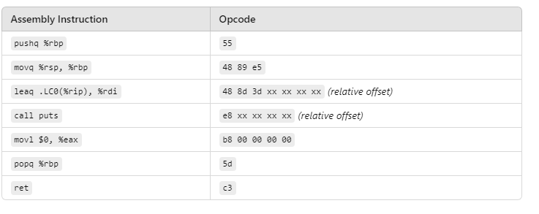
Machine code for Hello world
Only some part of program is shown here

Slide 22
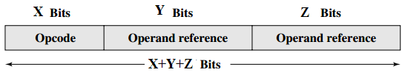
Instruction format
Operands are also represented symbolically. For example, ADD R1, R2 where R1, R2 are the registers
Instruction format

Slide 23
How CPU performs these instruction cycles?
It uses following registers for this
• Program counter (PC/IP):Contains the address of an instruction to be fetched
• Instruction register (IR):Contains the instruction most recently fetched
• Memory address register (MAR):Contains the address of a location in memory
• Memory buffer register (MBR):Contains a word of data to be written to memory or the word most recently read

Slide 24
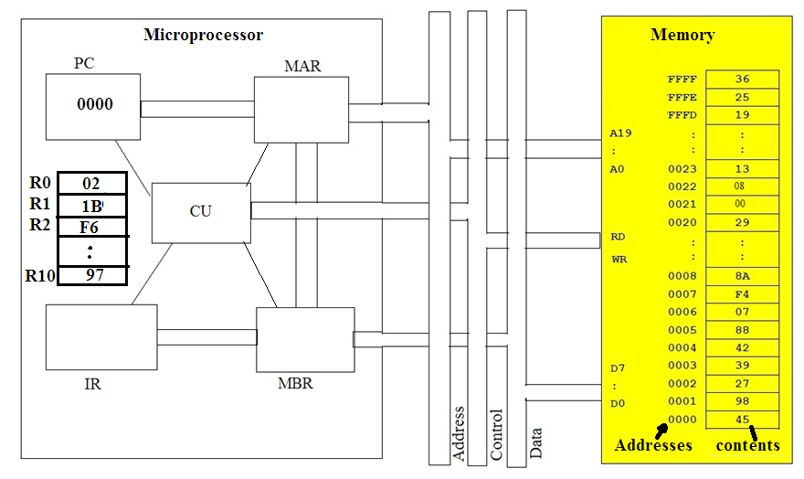

Animation of how processor executes instructions
When CPU is turned ON , it starts fetching instruction from address 0000 ,
So it loads PC with 0000

Slide 25
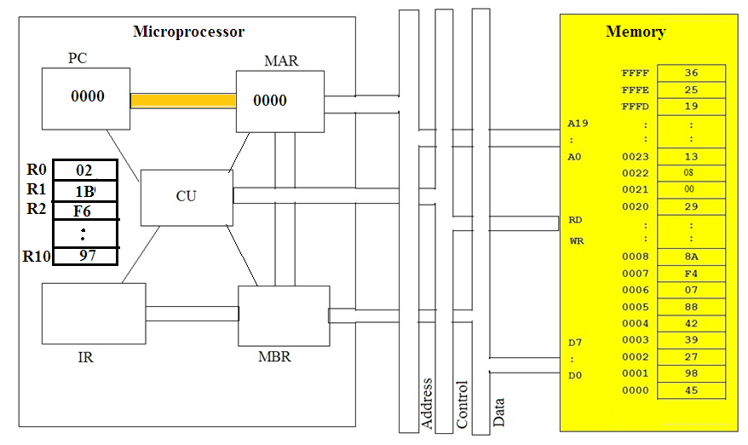
Contents of PC Is transferred to MAR

Slide 26
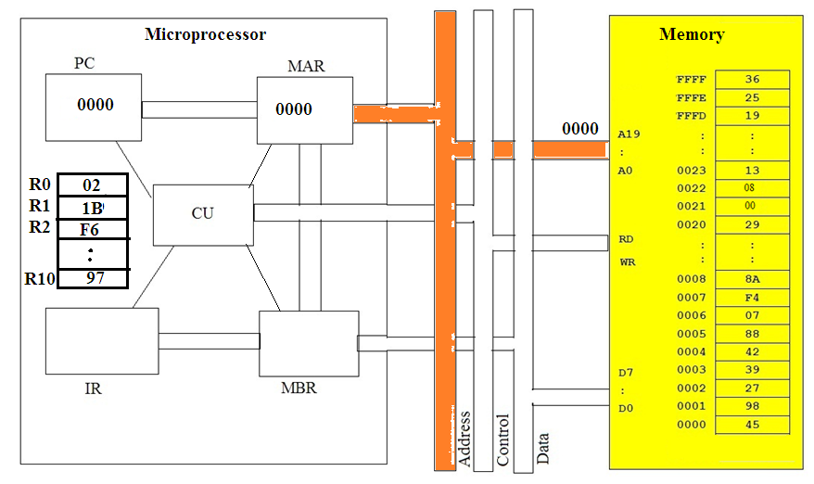
Contents of MAR are sent on address bus

Slide 27
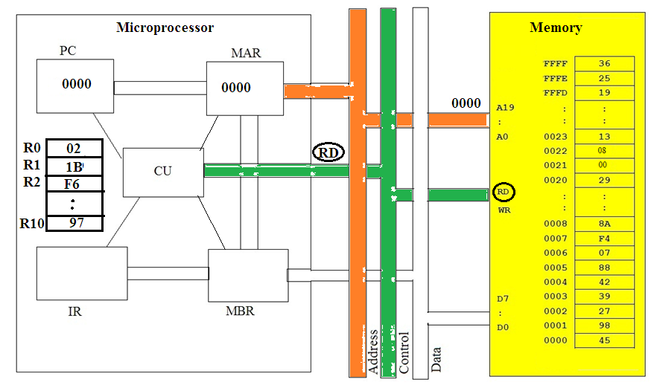
CU then sends read ( RD) signal on control bus

Slide 28
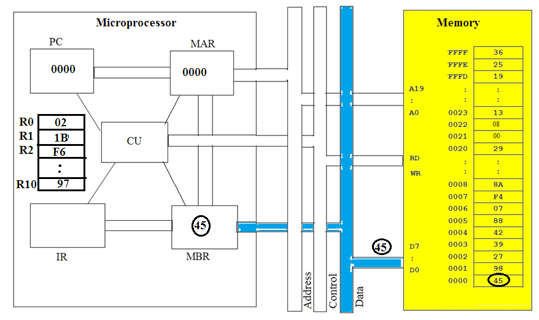
Memory sends contents of address 0000 on data bus which is laded in MBR

Slide 29
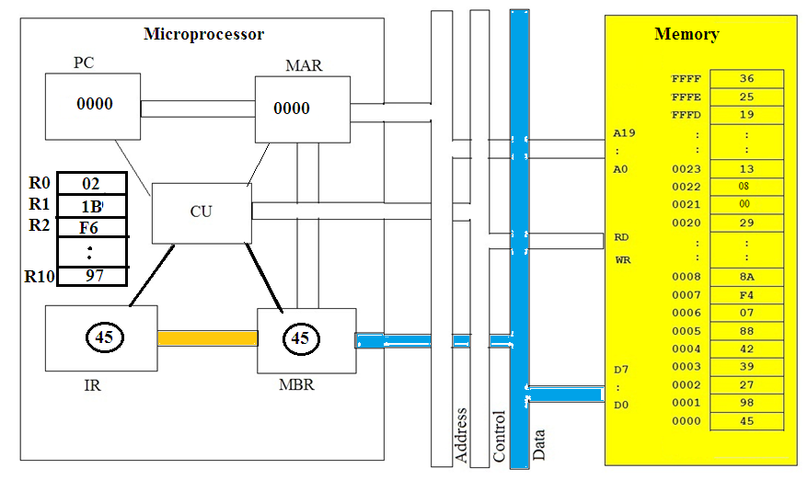
CU transfers MBR contents to instruction register IR , since it is an instruction

Slide 30
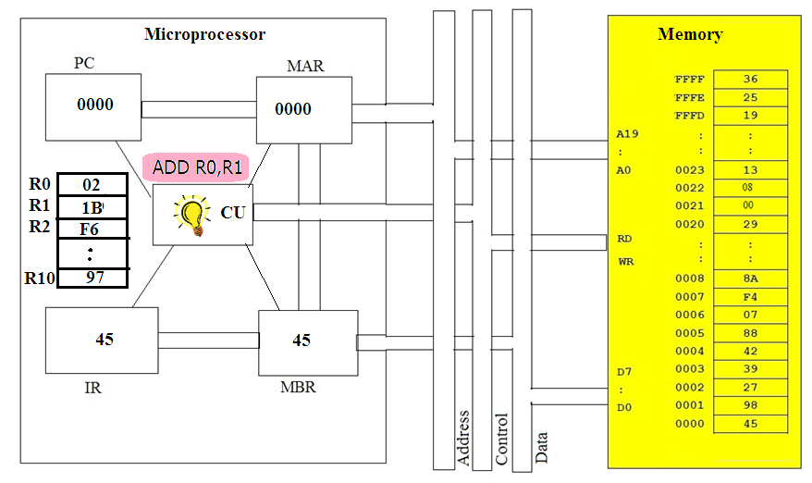
CU decodes instruction , it finds that R1 is to be added in R0 and
result to be stored in R0

Slide 31
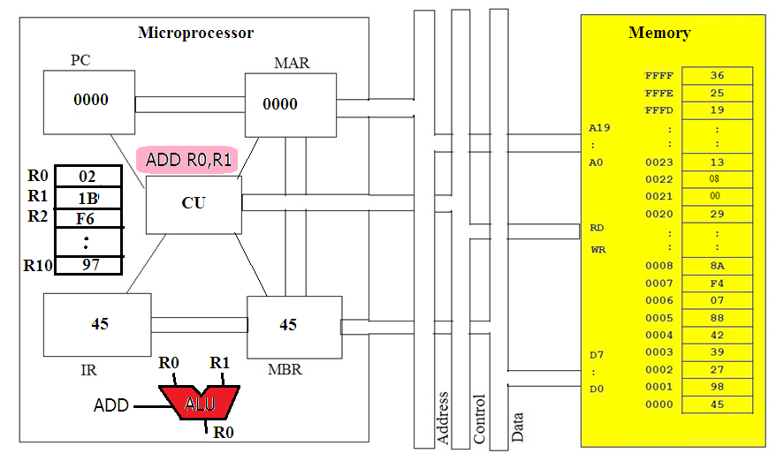
CU gives R0 and R1 contents to ALU and gives add signal to ALU

Slide 32
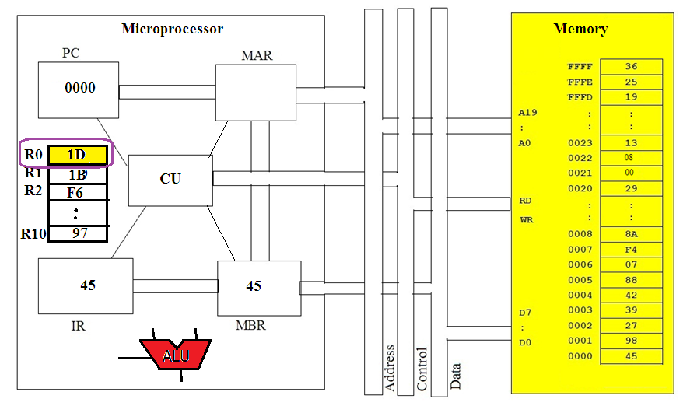
The result of addition is transferred by CU in R0

Slide 33
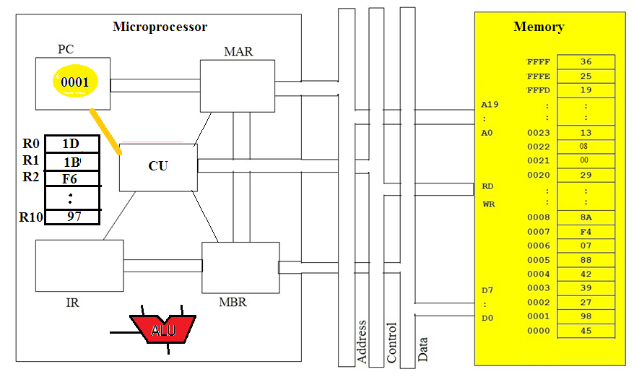
CU then increments PC by 1 to fetch next instruction from 0001

